Slide 1
Effects of average neuron connection distance on traveling wave propagation
Vincent Baker
Drexel University Department of Physics

Slide 2
Plan, method, results
Plan: Investigate whether longer distance connections may retard traveling wave propagation
Method: use a normal distribution and control the average connection length while maintaining roughly the same number of connections
Result: Longer connection lengths change the nature of the traveling wave, with “wider” waves and re-firing. The automated metric shows a sharp drop in propagation speed, but a manual measurement of the leading edge of the wave shows that propagation speed does not decrease.

Slide 3
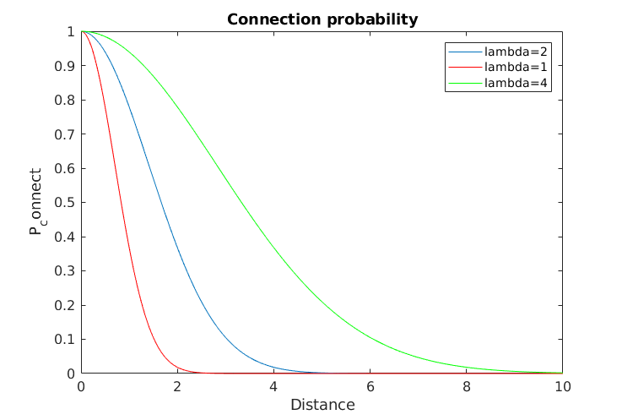
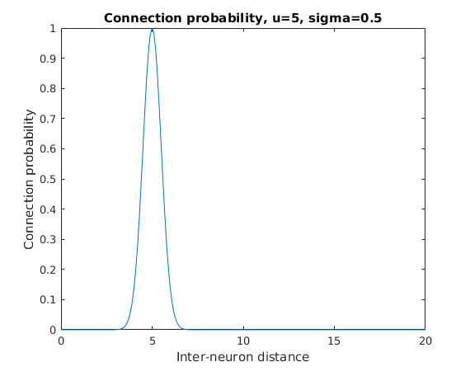
Connectivity Models
Distance-based exponential (previous model)
Normal-shaped probability distribution (current model), vary the mean parameter to control average connection distance

Slide 4
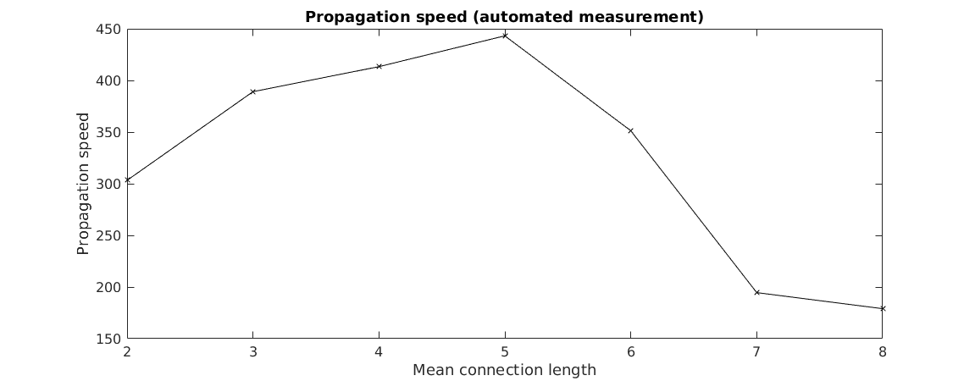
Propagation results
Using the automated propagation measurement we see a peak wave speed when the average connection length is 5
Manual inspection of the firing diagrams show that the leading-edge speed does not change, but the qualitative shape of the wave does (next slide)

Slide 5
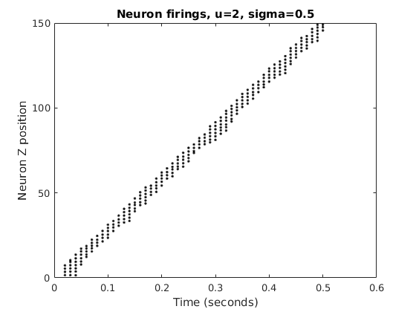
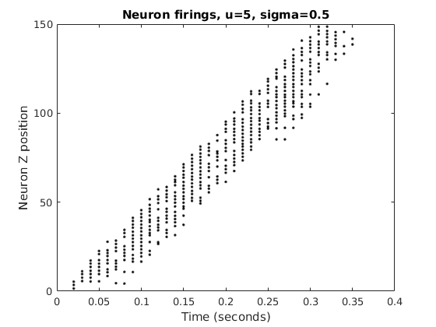
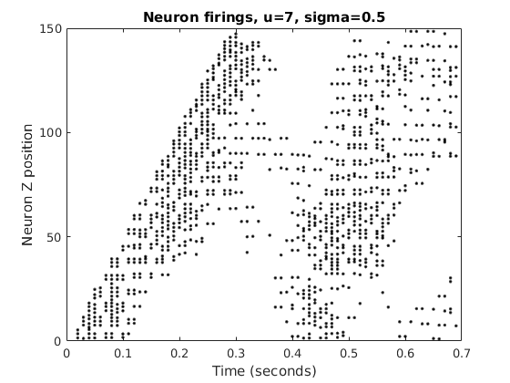
Propagation
At longer connection lengths we see “wider” waves and re-firing
Leading edge velocity doesn’t seem to change much, might even be getting faster
Leading-edge measurements show similar speed, even though the automated measurement shows speed dropping by half

Slide 6
Notes
Exponential connectivity with increasing lambda
Higher lambda makes fatter, faster waves
At critical value we see re-firing
Wave separation?
Normal connectivity
Higher range connectivity makes fatter, faster waves
At critical value we see re-firing
Wave separation?
Paper #1 – Narrative with figures
Traveling waves in 1-D systems (2x2, 3x3)
Behaviors by parameters: annihilation, echo, density/initiation correlation, phase space of connectivity/delay for velocity, delay behavior is normal, connectivity behavior
Paper #2: Column ensembles with Joe’s delta parameter

